Slide 1
Transition Packet
We’re Moving Signs, Arrows

Slide 2
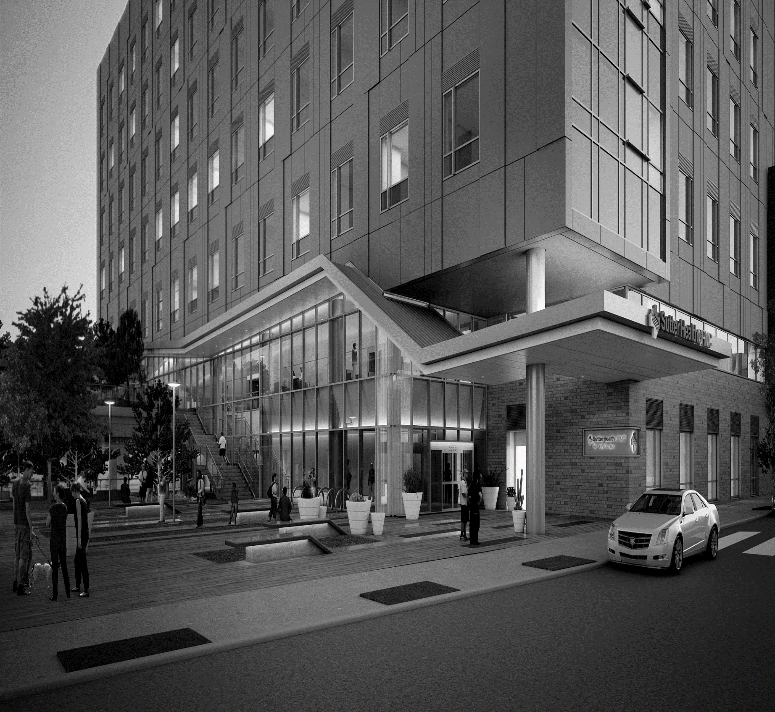
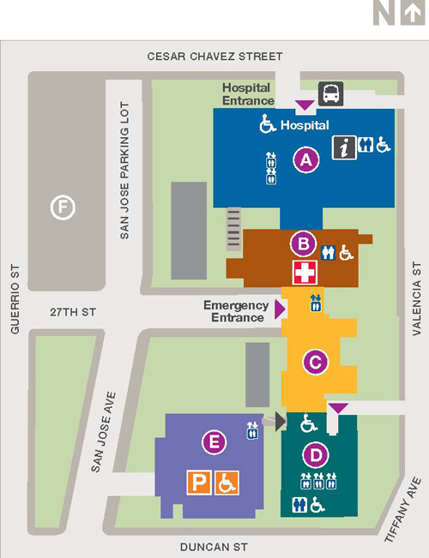
We’re Moving
As of August 25th XXXXXXXX will be located in the:
Monteagle Building Floor X, Room XXX
Monteagle Building

Slide 3
We’re Moving
As of August 25th XXXXXXXXX will be located in the:
1912 Building Floor X, Room XXX
1912 Building

Slide 4
We’re Moving
As of August 25th XXXXXXXXX will be located in the:
1957 Building Floor X, Room XXX
1957 Building

Slide 5
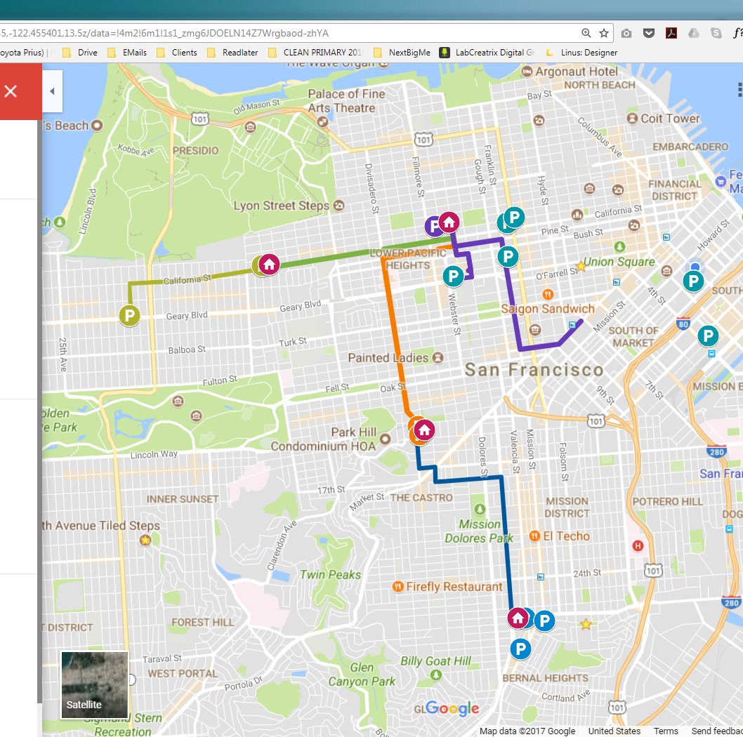

We’re Moving
As of August 25th Cardiac Rehab will be located at Mission Bernal Campus in the:
Monteagle Building Floor X, Room XXX
Pac Campus
Cal Campus
Van Ness
Davies
Mission Bernal
Notes:
Next slide for selecting your location

Slide 6
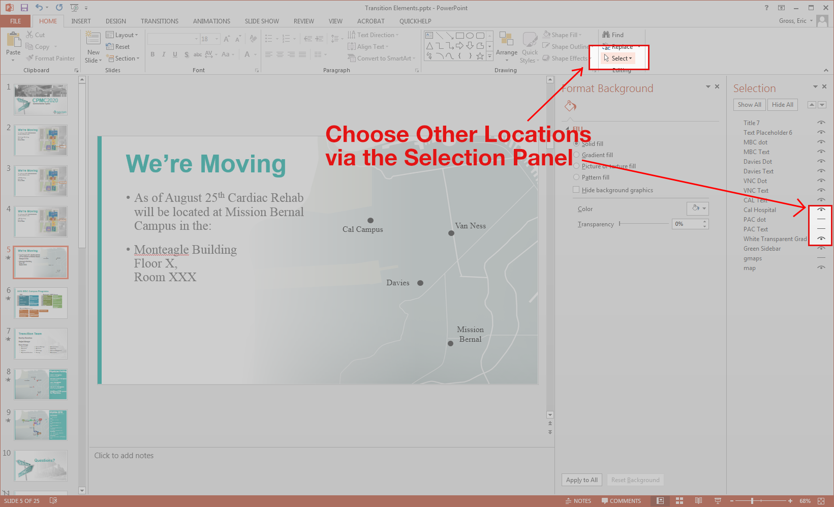

Slide 7

Shuttles 2018
B: BART Civic Center to PAC
Every 10min AM/PM
Every 30min Midday
C: CAL to PAC
30min
D: DAVIES to PAC
30min
K: Kabuki Hotel to PAC
20min
MB: MB to DAVIES
30min
JC: JAPANTOWN to PAC
10min AM/PM
GG: Geary Garage to CAL
20min AM/PM
SAC: BART Civic Center to 1825 Sacramento
30min PM Only
MB24: MB to BART 24th Mission
30min
Pac Campus
P
P
SAC
P
GG
P
C
Cal Campus
P
Van Ness
P
P
P
JC
D
B
P
Davies
P
MB
MB24
Mission Bernal
P
P

Slide 8
Visitors This Way

Slide 9
Visitors This Way

Slide 10
Visitors This Way

Slide 11
Visitors This Way

Slide 12
Visitors This Way

Slide 13
New Patients To Shuttle

Slide 14
New Patients to Shuttle

Slide 15
New Patients This Way

Slide 16
The following are hidden slides.
Use if appropriate, review for accuracy.

Slide 17
2018 MBC Campus Programs
1912
Monteagle / 1580 Valencia
Remain in place
Remain in Place
Breast Health
Admin
Lab Draw
Engineering
Chapel
Care Coordination
Retail (Walgreens)
Info Services & Auxilio
Diabetes Center
Scheduling
Imaging
Interpreter Services
EVS Offices
Volunteers Office
Specialty Clinics & HCC
Newborn Connections
Non-Invasive Cardiology
Hartzell Bldg*(new in 2019)
Admin
Clinical Research
Pulmonary Rehab
Antepartum Testing
Engineering
Cardiac Rehab
Pulmonary Function Lab
Notes:
Validate with Hamila SPMF for Non-Invasive Cardiology (and Breast Health).
Propose to renovate space in both the Stanford and Buchanan buildings to accommodate programs from Cal campus.
Buchanan would house Breast Health Center in imaging space, all others to go to Stanford.
For office space, renovations would be minor – furniture, paint.
*Hartzell occupants, including the mail room, may need interim location during construction.
Imaging - Monteagle -- yes primarily X-ray (1580 Valencia #411, X-ray, Ultrasound, Fluoroscopy)
MD Clinics- Specialty Clinics &. HCC are in Monteagle. I would rename to this (YES - 1580 Valencia #106, Specialty Clinic)

Slide 18

MOB Clinics
1580 Valencia St
3830 California St
2100 Webster St
45 Castro St
55 Second St
350 Rhode Is St.
595 Buckingham
899 Valencia St
1375 Sutter St
1500 Van Ness Ave
1580 Valencia St
1625 Van Ness Ave
2100 Webster St
2300 California St
2323 Sacramento St
2324 Sacramento St
2340 Clay St
3700 California St
3801 Sacramento St
3838 California St
1431 Noriega St
Castro & Duboce St

Slide 19
2020 Future State
PAC Campus (renovated space Stanford)
PAC Campus (remain in place)
Accreditation & Licensing
CPMC Research Institute
Ambulatory Surgery
Care Coordination (Overflow)
2016 Locations:
Auxilio
Diabetes
Cancer Center
Centralized Mail
PAC
CAL
Davies
633 Folsom
Library
Breast Health Center
Infection Control
Cardiac NIL
HELP
Informatics
Melanoma & Head/Neck
Histo Lab
Program in Medical and Human Values
IS (PAC)
Risk Management
Library Operations (Gerbode)
Quality & Safety
Medical Staff Services
WHRC
Organ Failure Biorepository
Melanoma (SPMF)
Nuclear Medicine
Pelvic Medicine
Head & Neck (SPMF)
Pharmacy Limited
Nuclear Medicine
Notes:
EG Note – Verify with Tami, remain in place of Melanoma, Head&Neck SPMF
Clean up Pharm

Slide 20
2020 Future State Continued
Davies Campus
2100 Webster
Psychiatry IP & OP
Pathology
Breast Care Clinic (SPMF)
GME / FHC (SPMF)
2016 Locations:
PAC
CAL
Davies
633 Folsom
Library
eICU
PT/OT
Outpatient Lab
Imaging Services
VNC
MBC
Infection Control
Gastrointestinal & IES
Anti-Partem Testing
Cardiac Rehab
Outpatient Pulmonary Function
Imaging
Pulmonary Rehab
VNC MOB
Imaging
OB Gyn Ultrasound

Slide 21
2020 Future State Continued
1625 Van Ness Ave.
New Space SF
2016 Locations:
Admin / Care Coordination
Spiritual Care / Chaplains
Admin
PAC
CAL
Davies
633 Folsom
Library
Quality Development Promotion Office
Information Services
3838 California
Outside SF
Imaging Services
Outpatient Lab
Information Services
1375 Sutter
Where?
Imaging Services
Outpatient Lab
Anticoagulate Clinic
2100 Webster
Imaging Services
Outpatient Lab

